Slide 1
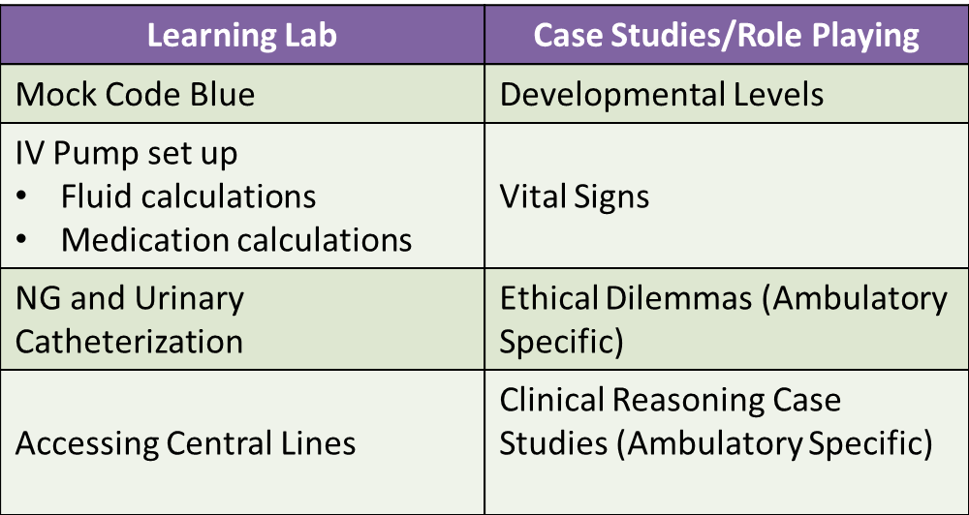
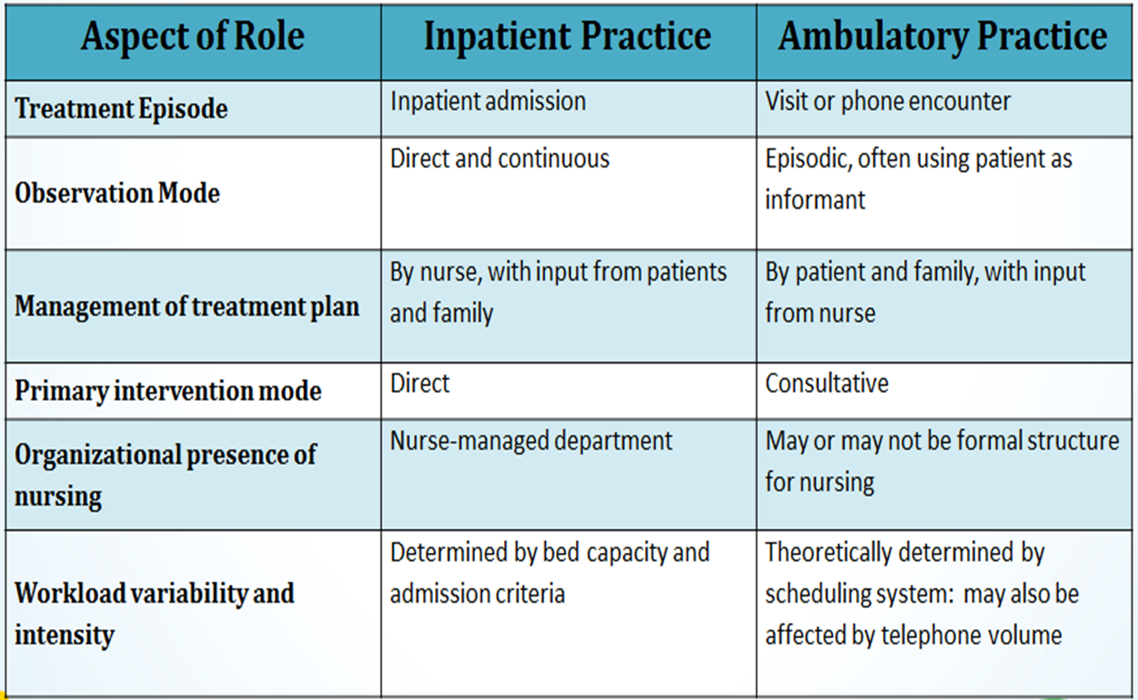
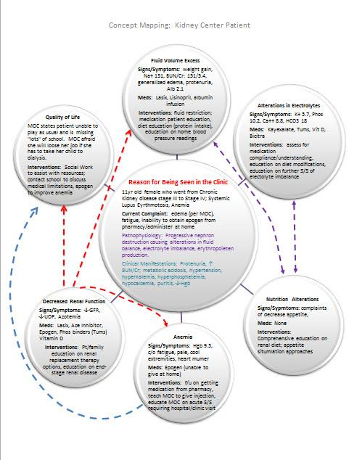
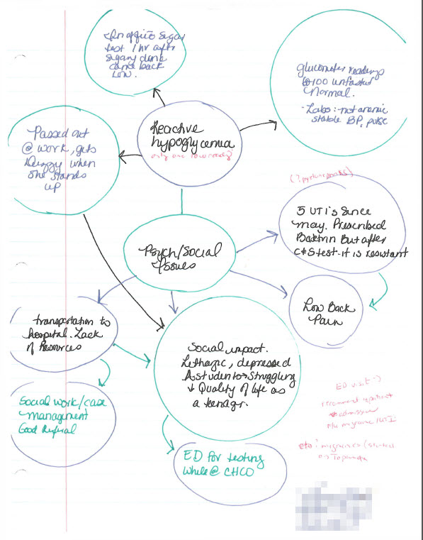
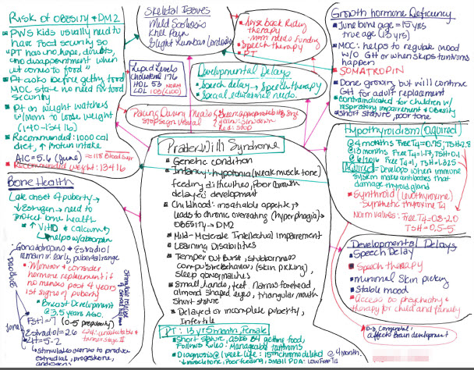
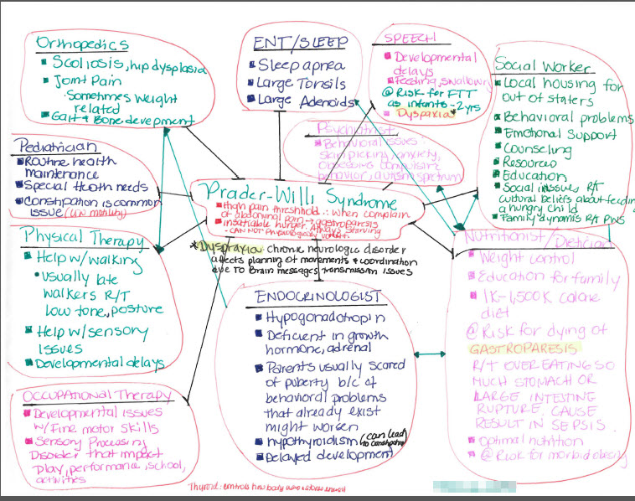
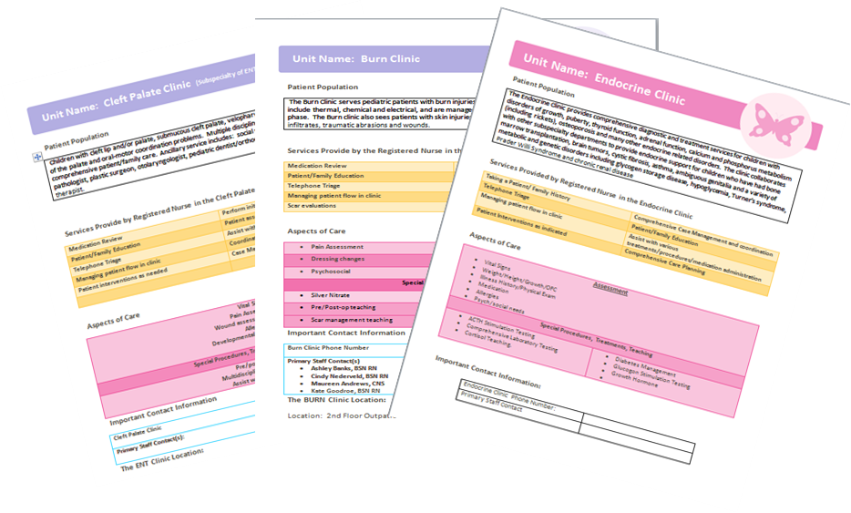
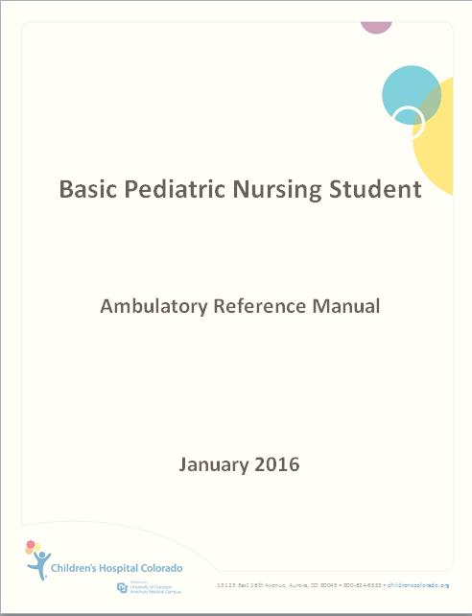
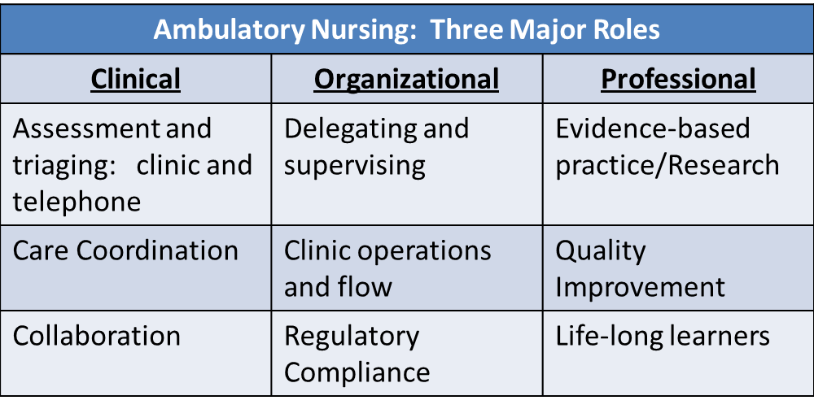
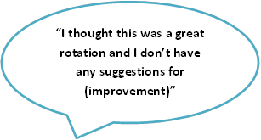
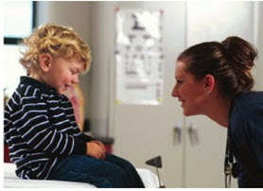
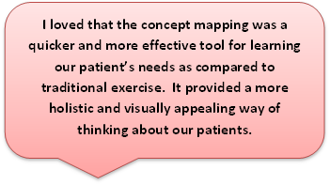
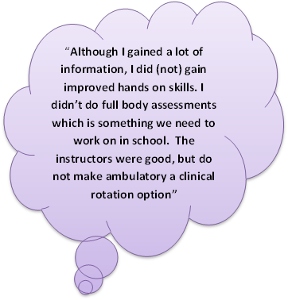
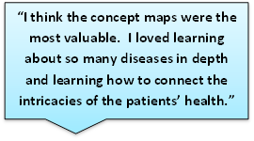
Breaking Tradition: Alternative Pediatric Experiences in Ambulatory Clinics Karen LeDuc, DNP, APRN, CNS, CNE, CPN¹; Laurel L. More, MS, RN, CPN²; Kristen Coleman, MS, RN, CPHON²
¹Regis University, Loretto Heights School of Nursing, ²Children’s Hospital Colorado
Background
Methods
Skill and Task Attainment
Primary focus for the novice student nurse
Ambulatory settings not highly task oriented
Strategy : Pre and Post Conference
Care Coordination and Clinical Reasoning
Use of concept mapping to promote understanding and use of nursing process:
Clinical Scholar Development
Ambulatory Clinical Scholars enhance the ability to bridge the knowledge to practice gap in their specialty area of nursing
Ambulatory Clinical Nurse Educator attended comprehensive workshop offered by the Colorado Center for Nursing Excellence and was instrumental in developing ambulatory clinical scholars.
Resulted in expanded opportunities for ambulatory nurses with graduate degrees to grow professionally, and promote the practice of ambulatory care.
In nursing education, the clinical context is recognized as an essential arena for students to learn about the realities of nursing practice. Current literature supports a changing landscape for health care delivery which shifts from acute care to ambulatory care settings. Exploration of alternative clinical learning environments is warranted, given this shift in nursing practice and potential nursing shortages predicted as early as 2020 in ambulatory settings. Historically, agency leadership, staff, and students have not supported the ambulatory setting as a viable learning environment for an undergraduate pediatric rotation.
.
Differences Between Acute Care and Ambulatory Care
Core Curriculum for Ambulatory Care Nursing , 2013
Purpose
Outcomes
Implications for Practice
Development and implementation of an undergraduate pediatric clinical rotation in an ambulatory clinical setting
Enhance collaborative relationships between a clinical agency and an academic institution
Support acquisition of the knowledge, skills and attitudes associated with pediatric ambulatory care
Clinical Reasoning with Concept Mapping
Clinical contexts are powerful in shaping student attitudes for learning, practice, and professional development. Academic and practice settings must re-examine current approaches to clinical education and seek experiences that prepare students for a changing practice environment. This program was developed to increase clinical placement capacity, and to implement a targeted and innovative learning environment for nursing students enrolled in a pediatric course. Facilitating effective clinical learning for pediatric nursing students is increasingly challenging given limited opportunities in most communities. This innovative program re-examined clinical teaching paradigms to maximize student learning in an ambulatory pediatric setting meeting established curricular goals, and served as a successful model for effective clinical instruction.
First Concept Map
Last Concept Map
Metrics
Outcome metrics show no difference between acute care and ambulatory care experience as measured by:
Kaplan Integrated Pediatric Exam
Final course grades
Anecdotal (Site Evaluation)
“Every day was a learning experience. My clinical scholars did an excellent job with pre/post conference……these have been the most effective student conferences so far.”
Atay, S. &Karabacak, U., (2012). Care plans using concept maps and their effects on the critical thinking dispositions of nursing students. International Journal of Nursing Practice, 18. 233-239. http://doi: 10.111/j.1440-172X.2012.02034.x
Laughlin, B. C. (2013). Core curriculum for ambulatory care nursing. (3rd ed.) Pitman, NJ: Anthony J. Jannetti, Inc.
Pudelko, B., Young, M., & Charlin, B. (2012). Mapping as a learning strategy in health professions education: a critical analysis. Medical Education, 46, 1215 – 1225. http:// doi:10111/medu.12032
Schuster, P. M. (2012). Concept mapping: A critical thinking approach to care planning. Philadelphia, PA: F.A. Davis Company.

