Slide 1
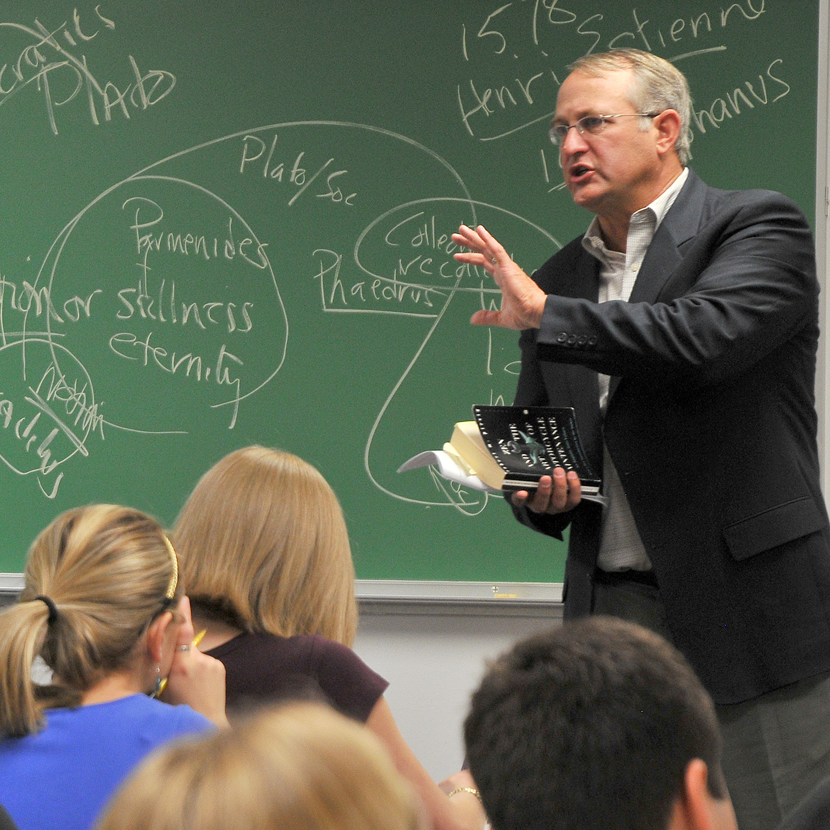
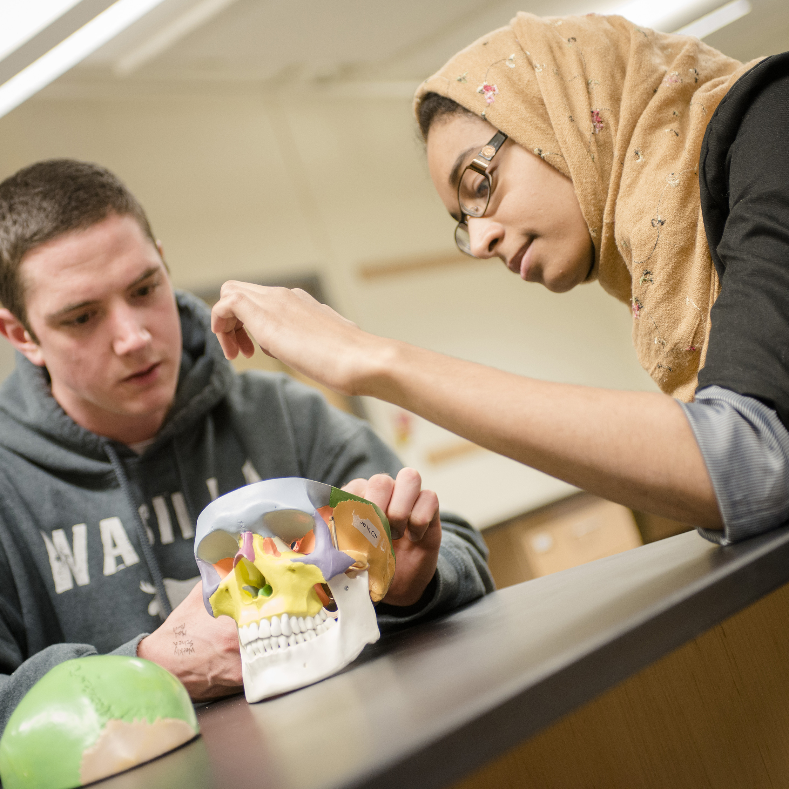
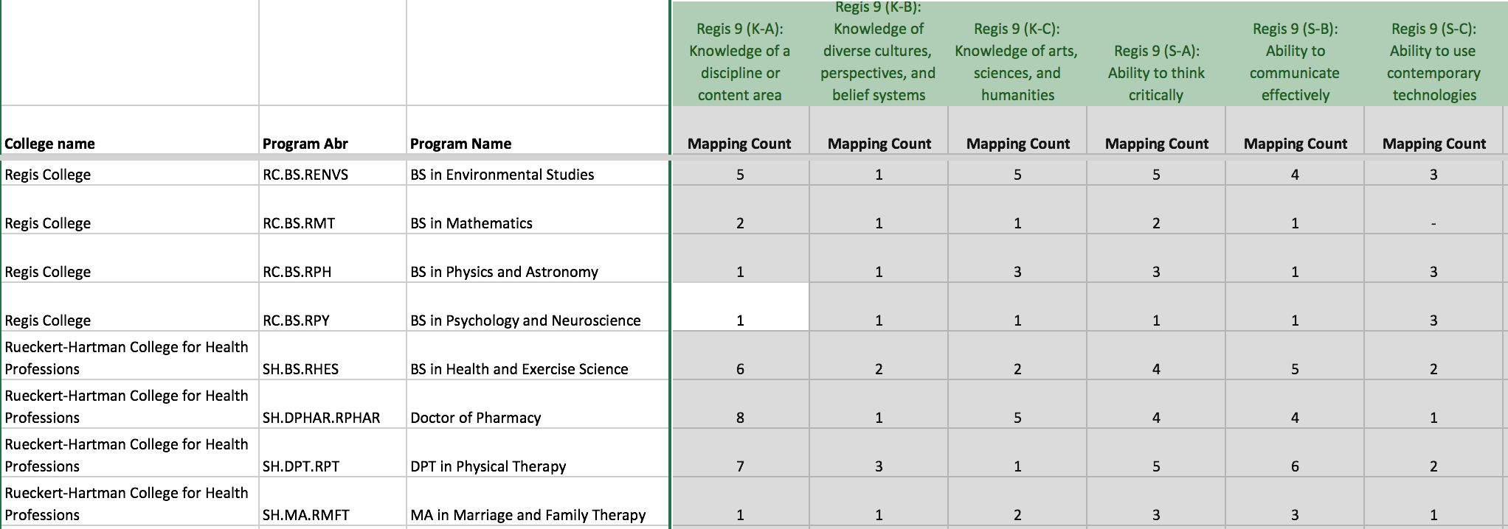
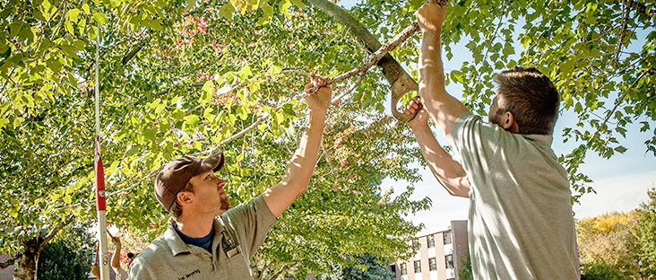
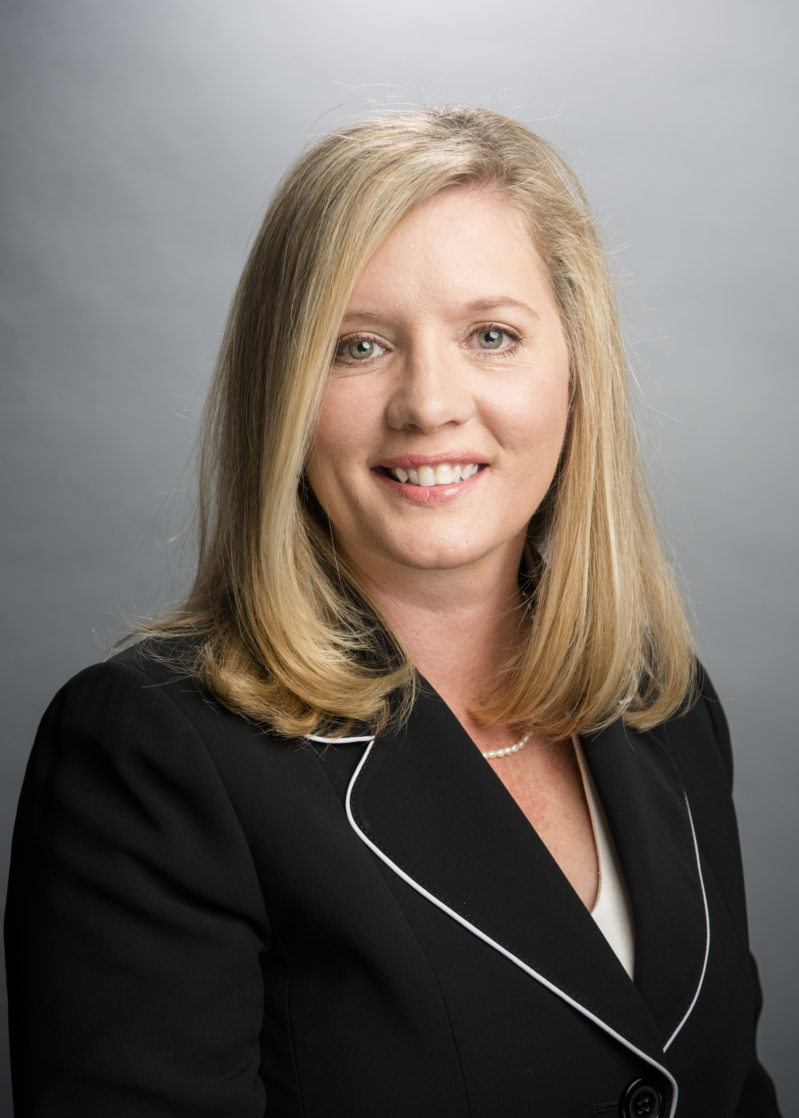
R.U. Learning: An Institutional Assessment Plan Haight, Robert C.; Oakes, Janna Regis University Assessment Committee
University Non-Negotiables
Template for the Assessment of Student Learning (TASL)
Our University Mission & Six Key Jesuit Values MISSION Regis University educates men and women of all ages and faiths to take leadership roles and to make a positive impact in a changing society. Standing within the Catholic and United States traditions, we are inspired by the particular Jesuit vision of Ignatius Loyola. This vision challenges us to attain the inner freedom to make intelligent choices. We seek to provide value-centered undergraduate and graduate education, as well as to strengthen commitment to community service. We nurture the life of the mind and the pursuit of truth within an environment conducive to effective teaching, learning and personal development.
Consistent with Judeo-Christian principles, we apply knowledge to human needs and seek to preserve the best of the human heritage. We encourage the continual search for truth, values and a just existence. Throughout this process, we examine and attempt to answer the question: "How ought we to live?"
As a consequence of Ignatius Loyola's vision, particularly as reflected in his Spiritual Exercises, we encourage all members of the Regis community to learn proficiently, think logically and critically, identify and choose personal standards of values, and be socially responsible. We further encourage the development of the skills and leadership abilities necessary for distinguished professional work and contributions to the improvement and transformation of society.
KEY VALUES IN JESUIT HIGHER EDUCATION 1. Cura Personalis 2. Magis 3. Men and Women For and With Others 4. Unity of Mind and Heart 5. Contemplatives in Action 6. Finding God in All Things
The “Regis Nine” The “Regis Nine” are our institutional learning outcomes, which have been in place for more than 20 years. They represent knowledge, skills and values that graduates of our programs should possess.
Establishing a “Culture of Inquiry” Regis University desires to shift its culture to one of both inquiry and continuous quality improvement. Specifically, the University would like to move from a highly-individualized, strictly instructional-based assessment approach to a more cohesive, university-wide approach that provides:
Common foundational standards for program assessment and evaluation within a process that honors each individual college’s unique and autonomous approach to the assessment of student learning and,
Institutional effectiveness standards and processes for administrative support units within the University.
To ensure that assessment remains a sustainable priority and is embraced by our stakeholders, Regis University seeks to design and implement a sustainable university assessment plan that:
promotes collaboration across institutional units,
is mission-driven,
promotes a culture of inquiry,
captures the diversity across all colleges and units,
engages faculty and staff in the process,
provides a framework for the assessment cycle, and
puts our relationship with students first.
Honor Existing Accreditations, Approvals & Standards Regis University has five colleges, and some have unique program-specific accreditations. Similarly, other programs have professional, conference, and/or professional standards to which they are bound. The assessment-related inherent in these associations requirements must be honored and incorporated into assessment and institutional effectiveness efforts.
Maintaining Some Flexibility for Individual Units Recent organizational shifts require a more decisive, 21st century approach to assessment and continuous improvement that is grounded in our mission and our institutional outcomes, yet also honors the unique nature and strengths of the five colleges and specific units.
Mapping Program Outcomes to Institutional Outcomes
Institutional Outcomes Report by Degree Program
The Template for the Assessment of Student Learning (TASL) is a multi-tab spreadsheet that guides units though the implementation, planning, and assessment cycles. The spreadsheet includes worksheets for the following assessment steps:
Implementation Stage:
Mapping Program Learning Outcomes to Institutional Learning Outcomes
Mapping Program Learning Outcomes to Courses
Planning Stage:
Planning Cycle Report (What will be assessed and how)
Assessment Cycle:
Collect Data and Initial Reactions
Analyze and Reflect
Implementation of Changes
Knowledge | Knowledge of a discipline or content area Knowledge of diverse cultures, perspectives, and belief systems Knowledge of arts, sciences, and humanities
Skills | Ability to think critically Ability to communicate effectively Ability to use contemporary technology
Values | Commitment to ethical and social responsibility Commitment to leadership and service to others Commitment to learning as a lifelong endeavor
University-wide Reporting
A faculty member from the College of Computers and Information Systems, Bob Mason, designed a stand-along database system that allows for the importation of the spreadsheets into a centralized system. This system allows for reports to be generate that will aggregate results from across the University.
At Regis University, Assessment is Everyone’s Business
Not Just for HLC: Broadening the Understanding of “Why”
Strategy at Work
If EVERY unit will engage in the work of assessment, we must start by defining the types of units that comprise our community.
Instructional Units An instructional unit is responsible for delivering graded curriculum that cumulates in the conferral of a certificate, undergraduate or graduate degree through a combination of required and elective courses.
Examples include academic departments such as the English Department, School of Nursing, Criminology Department, Economics Department, and the Data Science Department.
Co-Curricular and Extra-Curricular Units Co-Curricular units provide programming that is intentionally aligned with the curriculum.
Examples include speaker series, clinical supervision units, student teaching supervision units, and service learning.
Extra-curricular units provide academic support in the form of programs that enhance student learning experience both inside and outside the classroom.
Examples include student clubs and organizations, student activities, and extramural sports.
Operational Units Operational units serve important administrative functions at the university that occur outside of academic affairs and that are not explicitly aligned with the curriculum or the Regis Nine learning outcomes. Operational units support the learning efforts throughout the University. Assessment work within operational units is commonly referred to as “institutional effectiveness.”
Examples include Accounting, Physical Plant, Information Technology, Financial Aid, Admissions, and University Advancement.
We engage in the meaningful work of continuous quality improvement, which means that we use evidence to inform decisions regarding improvements, changes, and interventions at our University.
Our New Normal
Discourse is okay
Our culture has historically been one that expects of its members a high level of collegiality. As a result, discourse became rare among peers and between colleges. With members of the University Assessment Committee, it has been both necessary and helpful to not be afraid to disagree with one another for an open dialog. For members of the Assessment Academy Team, the first time was tenuous, but a team trip to the hotel happy hour helped everyone through the initial awkwardness!
Having an understanding of each individual’s background and point-of-view related to assessment aids in the richness of discourse. Due to this richness in discourse, the University Assessment Committee has been able to better understand the needs and wants of each unit and collaboratively create solutions for implementation.
Inclusiveness for Development
Ours was an “all hands on deck” approach. Grassroots support from University Assessment Committee members and commitment from our President, Provost, and Cabinet ensured the necessary visibility and support for units and individuals.
All faculty had a 30-day review and comment period, after which the proposed instructional assessment plan (RU Learning I) was approved by our University Academic Council. Subsequent to that approval, we sought and obtained formal affirmation from the Cabinet.
Outside the academic units, the development of the RU Learning II plan, included input from co-curricular and extra-curricular units. The input included convening a focus group prior to the development of the plan and a 30-day review and comment period for the completed plan.
RU Learning III ???
Implementation of RU Learning I
This transparency and inclusiveness, coupled with a bit of formality, turned out to be both wise and useful during the implementation process for RU Learning I, which implementation began in fall 2016. Having a campus-wide buy-in to the process made the roll-out of RU Learning II much more palatable to academic units.
After failing to learn the training needs that exist through the academic units, the assessment leads from each of the five colleges have begun to meet as a team to identify and develop training modules to address needs.
Implementation of RU Learning II
A similar response was found among co-curricular and extra-curricular units when the RU Learning II plan was introduced during two separate one-hour meetings during the beginning of the spring 2017 semester. Staff from these units were on average not surprised that such a plan was coming. This allowed for the meeting to discuss how the plan was going to be implemented across the co-curricular and extra-curricular units and identified some training needs that may exists.
A needs assessment has been developed and circulated to leaders in these units. The needs assessment was designed to identify areas to provide training related to assessment and the best method to deploy such training.
Plan for Implementation of RU Learning III
RU Learning III will be approved this spring, with maps due in May and Planning Cycle reports due in August. Many of these units are already engaged in some form of assessment, but know it by other names such as “annual audit, “LEED certification standards, etc.”
Two one-hour introductory meetings will be held with leaders of operational units in April, followed by departmental work sessions and trainings. A needs assessment will be conducted to identify areas to provide training related to assessment and the best method to deploy such training.
Instructional, Co-Curricular and Extra-Curricular Units
We engage in the meaningful work of student learning assessment in order to provide publicly-accessible evidence to our stakeholders that Regis University delivers on the promise that we make to students in the Regis Nine, the key Jesuit Values, and program learning outcomes.
Operational Units
We engage in the meaningful work of institutional effectiveness assessment in order to provide publicly-accessible evidence to our stakeholders that Regis University is a good steward of its resources and takes seriously its operational responsibilities and that we deliver on promises made through industry and professional standards.
We use the Plan-Do-Study-Act (P-D-S-A) assessment cycle:
PLAN what we want to learn more about and how we will gather evidence
DO our assigned tasks, collecting evidence along the way
STUDY the data we have collected
ACT to improve our programs, services, and operations based on what we learn from evidence collected.
Keys to Success: Timelines & Teams
Tactics for Engagement, Communication & Training
Contact Info
Five Colleges, Multiple Units, One University
Shared governance, grass roots approach
In instructional units the assessment effort is faculty led, dean supported
Shared vision for assessment across all five colleges, but with room for individual needs
Shared terminology
One plan with three parts: 1. R.U. Learning I (for instructional units) 2. R.U. Learning II (for co-curricular and extra-curricular units) 3. R. U. Learning III (for operational units)
Three-year assessment cycle to meet the needs of our diverse community
University Assessment Committee based on a representative model - Faculty representatives from all five colleges - Staff representatives from co-curricular/extra-curricular units - Staff representatives from operational units
Timeline that is realistic, attainable, and practical.
Robert Haight, Assistant Professor of Pharmacy & Co-Chair, University Assessment Committee rhaight@regis.edu (303) 625.1259
Janna Oakes, Professor & Associate Provost joakes@regis.edu (303) 964.6490
June 8 – 10, 2016 | Assessment Academy Team in Chicago for Team Session I
June 27, 2016 | Draft plan due to HLC Assessment Academy Collaboration Network System
June 13 – Aug 12, 2016 | UAC and Assessment Academy Team Finalize University Assessment Outline - Draft by July 13
July 18, 2016 | UAC members begin communicating about Fall Semester mapping project
August 12, 2016 | Coordinators send to faculty advanced communication
Aug 15, 2016 | DRAFT assessment plan available for University community review & feedback.
Aug 17, 2016 | DRAFT assessment plan presented as concept to RUAC
Sept 30, 2016 | Last day for community feedback
Oct 12, 2016 | DRAFT plan to RUAC for affirmation
Oct 14, 2016 | Revised plan to Provost & Cabinet for approval
Oct 17, 2016 | Cabinet deliberation and possible approval
Oct 28, 2016 | Affirmation vote requested from college faculty bodies by this date
October 2016 | Mid Semester Check In on Mapping
Nov 2016 | UAC and CETL Training Needs Assessment
Dec 2016 | Map 1 and Map 2 are due
Dec 2016 | End of semester check in
Dec 2016 | End-of-semester newsletter disseminated University-wide regarding progress, learning & use of data
Jan, 2017 | Start BI integration conversation
Feb 1 – Mar 15, 2017 | Communication & Training for co-curricular units
Mar, 2017 | Implementation for co-curricular units
Mar 2017 | Mid semester check in on report one and two – co-curricular
Mar, 2017 | Mid semester check in on report one and two - instructional
May, 2017 | End-of-semester disseminated University-wide regarding progress, learning & use of data
May – June, 2017 | Communication & training for operational units
June, 2017 | Implementation for operational units
Sept, 2017 | UAC refines plan based on feedback from operational units
Champions, Expansion, and… Whoops!
WIN Champions for different types of units
WIN HLC Assessment Academy (sub-group from University Assessment Academy)
WIN University Assessment Committee comprised of team players who are widely respected amongst their colleagues
WIN Expansion of University Assessment Committee to provide necessary “bandwidth” for implementation
PLANNED Decrease in size of University Assessment Committee after Cycle One
PLANNED “Work sessions” with co-curricular and extra-curricular units for mapping completion
TRY-AGAIN Anticipating training needs and fear associated with assessment
TRY-AGAIN Anticipating work load issues for faculty assessment leads within the colleges.
TRY-AGAIN A priori articulation of the level and type of support needed from deans
TRY-AGAIN A detailed communication plan aligned with the implementation timeline
2017-18 | 2018-19 | 2019-20 | 2019-20 | 2020-21 | 2021-22 | 2022-23
R. U. Learning Cycle One
Collect & record (3 ILOs) Complete TASL Year 1 Report | Analyze and reflect Plan changes Complete TASL Year 2 report Planning for next TASL | Implement changes Complete TASL Year 3 Report
 |  | R. U. Learning Cycle Two
 |  | Collect & record (3 ILOs) Complete TASL Year 1 Report | Analyze and reflect Plan changes Complete TASL Year 2 report Planning for next TASL | Implement changes Complete TASL Year 3 Report
 |  |  |  | R. U. Learning Cycle Three
 |  |  |  | Collect & record (3 ILOs) Complete TASL Year 1 Report | Analyze and reflect Plan changes Complete TASL Year 2 report Planning for next TASL | Implement changes Complete TASL Year 3 Report
References
Higher Learning Commission Assessment Academy
Anderson, L. W., & Krathwohl, D. R. (2001). A taxonomy for learning, teaching, and assessing: A revision of Bloom's taxonomy of educational objectives: Allyn & Bacon.
Banta, T. W., & Palomba, C. A. (2015). Assessment Essentials: Planning, implementing, and improving assessment in higher education (2nd ed.). San Francisco: Jossey-Bass.
Bloom, B. S. (1956). Taxonomy of educational objectives: The classification of educational goals: Cognitive Domain: Longman.
Larsen, R. W. (2011). Developing program learning outcomes. Retrieved from https://www.montana.edu/provost/documents/assessment/002%20Developing%20Program%20Learning%20Outcomes.pdf
Providing evidence of student learning: A transparency framework. (2012). Retrieved from http://www.learningoutcomesassessment.org/TFComponentSLOS.htm
Suskie, L. (2009). Assessing Student Learning: a common sense guide (2nd ed.). San Francisco: Jossey-Bass.

